Slide 1
FFs Tables

Slide 2
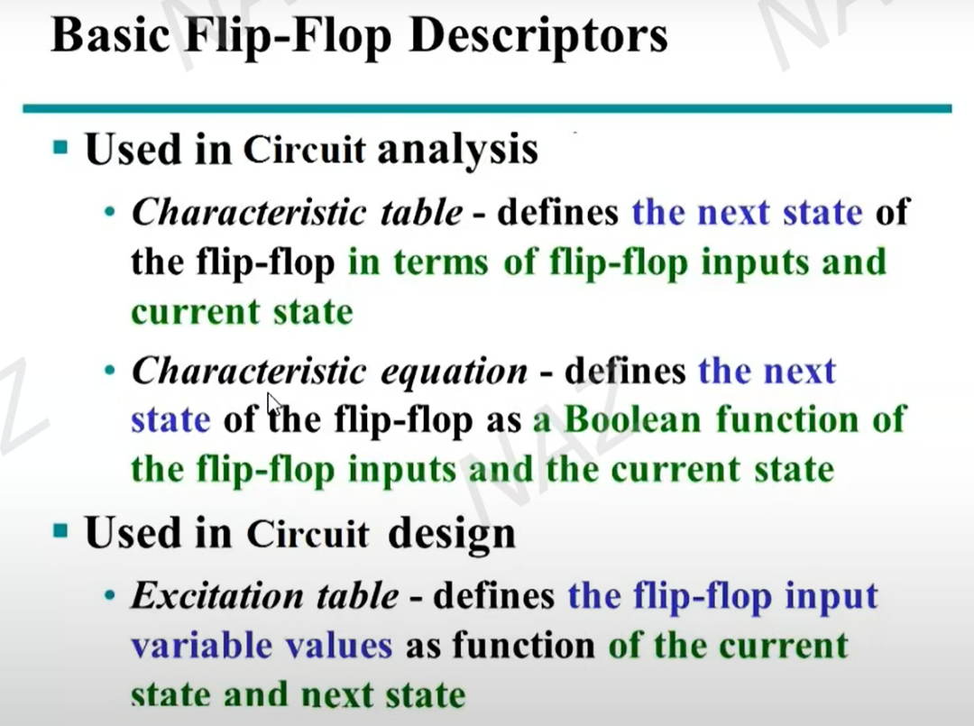

Slide 3
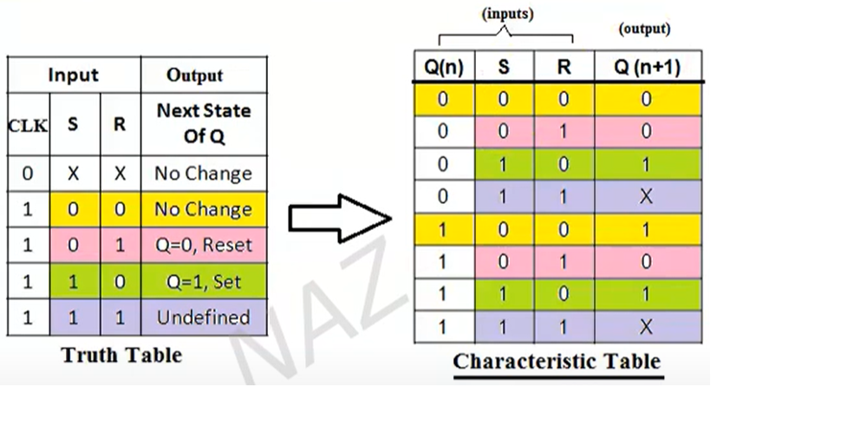
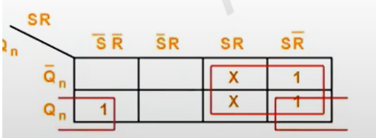
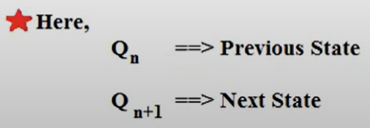
SR FF
Q(n+1) = S + Qn R
Characteristic Equation

Slide 4
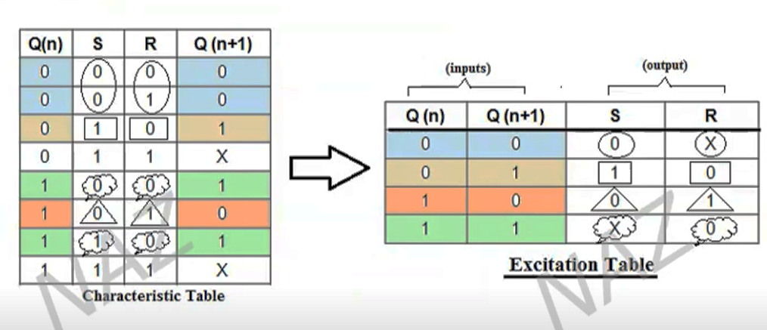
Excitation Table from Characteristic Table

Slide 5
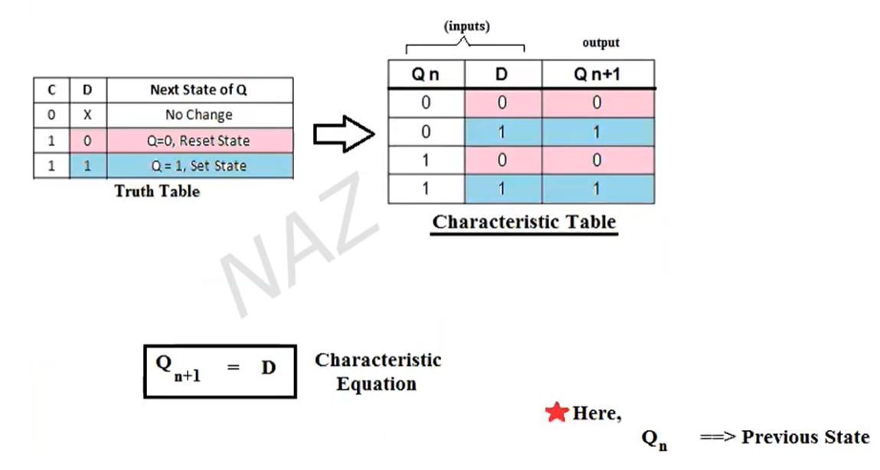
D FF

Slide 6
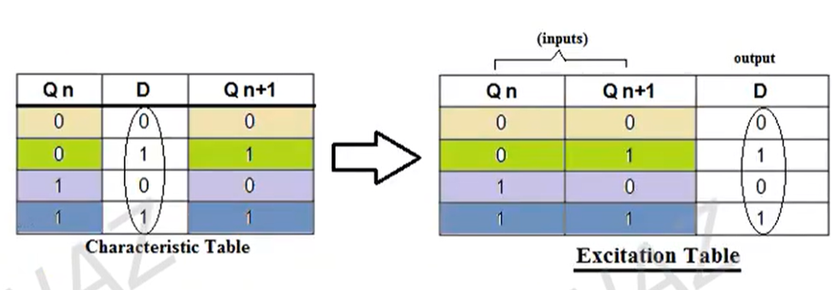
Excitation Table from Characteristic Table

Slide 7
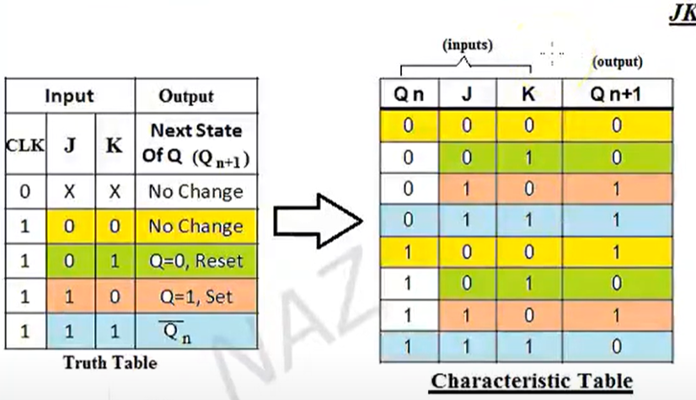
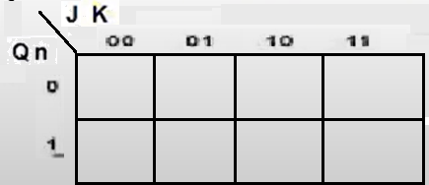
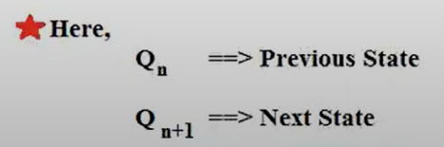
JK FF
Q(n+1) = Qn J + Qn K
Characteristic Equation

Slide 8
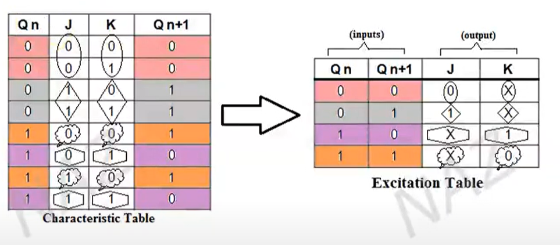
Excitation Table from Characteristic Table

